Slide 1
Do we really need to recalibrate or retrain
a brain-to-text decoder every day?
The decoder can stay frozen: recency-aware input-state management
Ron Nuriel
Yacov Hel-Or, Doron Friedman, Itzhak Fried, Rafael Malach, Eilon Vaadia, Sarel Cohen
previous → geometry retrieval → calibration only if needed
AdaptLadder-BCI · 1/13
Notes:
00:00–00:20. Open with the question. Say daily BCI calibration costs user time and labeled data. Main answer: not yes, not no—the GRU can stay frozen, but the input state must be chosen.

Slide 2
Daily recalibration is a user burden
In BCI, this is not a theoretical question.
1
2
3
User time
Labeled data
Long-term usability
Every calibration block is time the user spends maintaining the system.
Supervised updates need known prompts or labels at the start of the day.
A helpful BCI should not become hard to use because it needs daily tuning.
So the practical question is not only “can we retrain?”
Can we keep the decoder fixed and manage the input state instead?
AdaptLadder-BCI · 2/13
Notes:
00:20–00:40. Daily calibration costs user time and labels. It can make a system that should help harder to use. Transition: can we avoid retraining by managing input states?

Slide 3
Reframe the daily problem
Not “train every day”; first ask which historical input state fits today.
Old question
New question
How do we retrain
the model today?
Which historical input state
is compatible with today's brain signal?
Main finding
The decoder can stay frozen.
But the input state must be chosen.
input state = day-specific input layer / adapter
AdaptLadder-BCI · 3/13
Notes:
00:40–01:00. Instead of asking how to retrain the model, ask which historical input state is most compatible with the brain signal today.

Slide 4
Same frozen GRU. Different input adapter.
The GRU knows how to decode; the neural signal must enter through the right adapter.
Input state
Frozen GRU
Output head
Today's neural features
day-specific
input layer / adapter
no update
phonemes
T15 feature stream
✓
What changes?
Only the interface into the frozen decoder.
This is why we call the problem input-state management.
AdaptLadder-BCI · 4/13
Notes:
01:00–01:25. We are not proposing a new decoder. The official T15 GRU and output head stay frozen. What changes is the input layer: the adapter between neural features and the GRU.

Slide 5
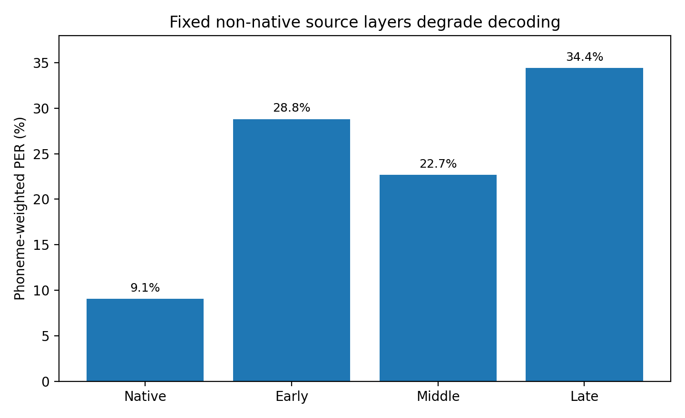
Result 1: wrong input-state selection breaks decoding
The decoder is not necessarily the problem — the interface into it is.
9.06%
22–34%
native-day
wrong state
correct daily input state
fixed non-native input layers
Same GRU. Different input state. Huge PER jump.
PER = phoneme error rate; lower is better.
AdaptLadder-BCI · 5/13
Notes:
01:25–01:50. First result: with the native input layer, PER is about 9%. With the wrong input layer, error jumps to roughly 22–34%. The GRU is not necessarily broken; the interface is wrong.

Slide 6
Simple correction is too weak; small calibration is partial
Mean/variance matching does not reproduce the right daily input layer.
22.73%
18.59%
9.06%
moment matching
20 labeled trials
native-day reference
Mean and variance correction stays near the fixed-source failure.
Input-layer calibration helps, but remains far from native-day.
The target is much lower when the correct state is used.
Calibration is useful — but it should not be the first move if a compatible state already exists.
AdaptLadder-BCI · 6/13
Notes:
01:50–02:15. We tested whether drift is just mean or scale. Moment matching stayed around 22.7% PER. Input-layer calibration with 20 labeled trials improves to 18.6%, but it is still far from native-day.

Slide 7
Best low-cost move: select a compatible past input state
Before retraining, check whether the right adapter already exists in history.
12.21%
12.74%
previous input state
geometry retrieval
Strongest simple policy at K = 20. No labels, no training.
Close to previous; retrieves candidate states, but needs a threshold.
This is the core ladder:
reuse previous → retrieve by geometry → calibrate only if needed
AdaptLadder-BCI · 7/13
Notes:
02:15–02:40. Stronger low-cost move: reuse or retrieve compatible input states. Previous reaches about 12.2% PER; geometry is close at about 12.7%.

Slide 8
What do we mean by “neural geometry”?
Each session becomes a cloud of neural-feature vectors.
T15 data shape
Flatten trials + time
Geometry = cloud shape
trials / sentences
×
time bins
×
neural features
each time bin
= one point
in channel space
Covariance tells us how channels move together.
If today’s cloud shape resembles a past day, that past input layer may still be compatible.
Uses a short unlabeled K-shot window: K = 5, 10, or 20 trials
AdaptLadder-BCI · 8/13
Notes:
02:40–03:05. Geometry means the shape of neural activity. Trials by time bins by features become a cloud. Covariance describes the cloud shape—how neural channels move together.

Slide 9
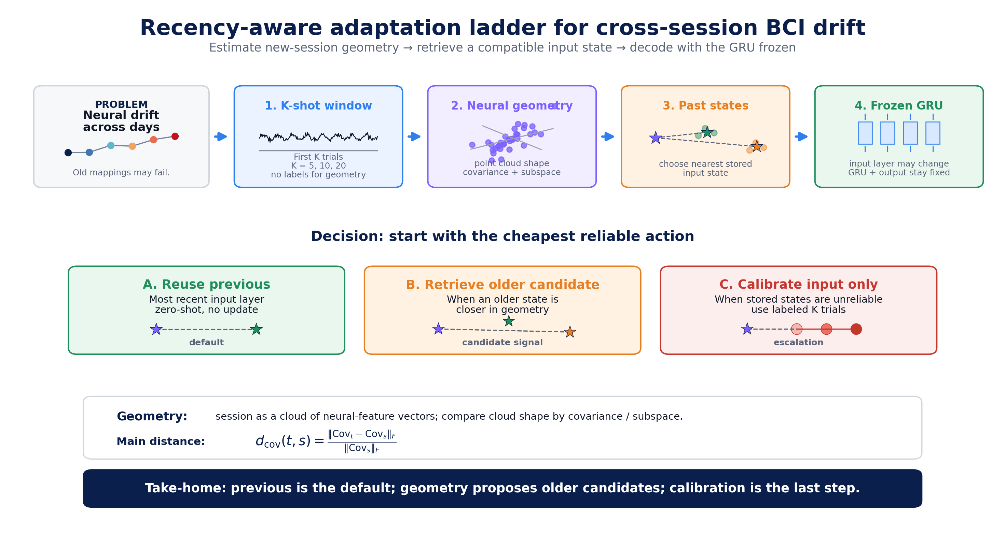
The adaptation ladder: start cheap, escalate only when needed
Figure 1 from the paper — the whole method in one picture.
Previous is default. Geometry retrieves candidates. Calibration is last.
AdaptLadder-BCI · 9/13
Notes:
03:05–03:40. This architecture slide can stay on screen slightly longer. A short beginning-of-day window estimates target geometry, compares it to stored input states, then chooses the cheapest reliable action: previous, geometry candidate, or input-only calibration.

Slide 10
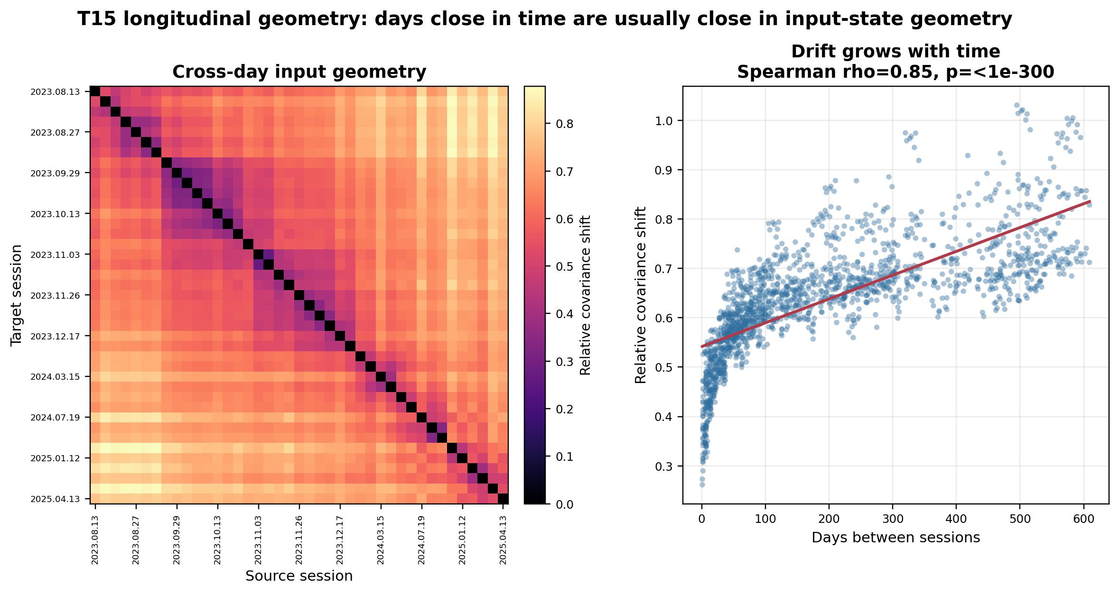
Result 2: drift is structured, not random
Nearby days are often nearby in geometry — but the trajectory is not perfectly monotonic.
diagonal band = nearby days have similar geometry
Spearman ρ = 0.85 = drift grows with time
non-monotonic cases = older states can matter
AdaptLadder-BCI · 10/13
Notes:
03:40–04:05. Drift is not random. The heatmap shows a diagonal band: nearby days tend to be close. The scatter shows covariance shift grows with time, rho about 0.85. But it is not perfectly monotonic, so older states can matter.

Slide 11
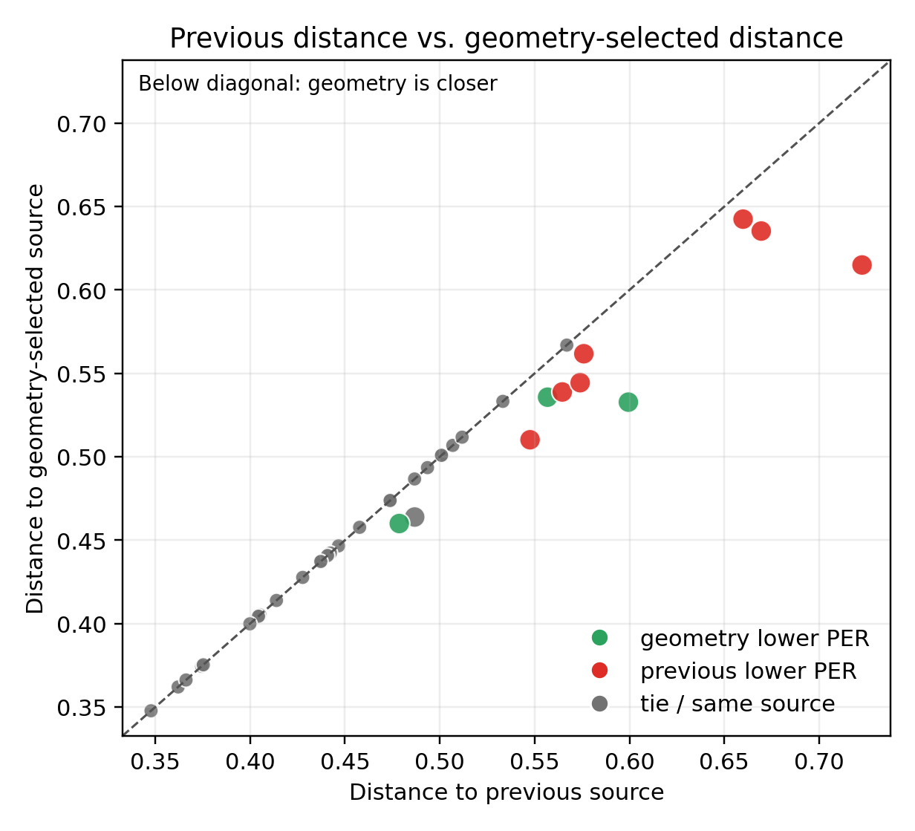
Result 3: geometry proposes candidates — it does not decide alone
Closer in covariance is not always lower PER. A confidence gate is needed.
26
11
3/11
selected previous
selected older
older wins
sessions
sessions
only three cases
7/11
3.23 pp
previous still better
false-positive cost
when older was selected
average PER penalty
Conclusion: geometry should nominate older states, not blindly override recency.
AdaptLadder-BCI · 11/13
Notes:
04:05–04:30. This is the caution. At K=20, geometry selected previous in 26 sessions and older in 11. Among those older choices, older wins only 3 times; previous still wins in 7, with one tie. Geometry is a candidate signal, not a full policy.

Slide 12
Operational answer: manage input states, not the decoder
Reuse → retrieve → calibrate.
1. Reuse previous
2. Retrieve by geometry
3. Calibrate input only
If the last state is recent
0–3 days: 9.97% PER
zero-shot, no labels
If previous is stale
K=20 geometry: 12.74% PER
nominate candidate
If no stored state is reliable
22.67 → 18.59% PER
fallback
The decoder can stay frozen; the system selects or lightly adapts the input state.
Next: confidence threshold, WER + LM decoding, and closed-loop validation
AdaptLadder-BCI · 12/13
Notes:
04:30–04:50. Operational answer: reuse previous when recent, retrieve by geometry when previous is stale, and calibrate input only if no stored state is reliable.

Slide 13
The decoder can stay frozen.
What needs to adapt is the input state.
Three takeaways
1
2
3
Wrong input states
break decoding
Drift has measurable
neural geometry
Geometry needs a
confidence threshold
Thank you
AdaptLadder-BCI · 13/13
Notes:
04:50–05:00. Close: no, we do not necessarily need to recalibrate or retrain every day. The decoder can stay frozen. What needs to adapt is the input state.

